Slide 1
Calculation Policy – Years 3 and 4
Monday 22nd November 2021

Slide 2
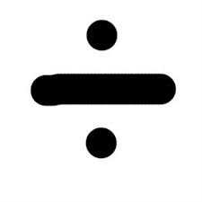
Division

Slide 3
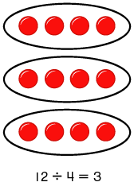
Stage 1 – Multiplication and Division
Practical use of halving, doubling and sharing, leading into repeated addition and basic use of the number line.

Slide 4
Stage 2
Arrays for division
9 ÷ 3
Draw an array of three, circle it and label it as ‘1’.
1

Slide 5
Stage 2
Arrays for division
9 ÷ 3
Draw an array of three, circle it and label it as ‘1’.
Continue with this until the number is reached i.e. until 9.
1
2

Slide 6
Stage 2
Arrays for division
9 ÷ 3 = 3
Draw an array of three, circle it and label it as ‘1’.
Continue with this until the number is reached i.e. until 9.
Count the number of sets, which gives you the answer.
1
2
3

Slide 7
Stage 2
Division as repeated subtraction using a number line (15 ÷ 5 = 3)
Start from the right at 15. Jump back in fives until zero is reached. Count the number of jumps.

Slide 8
Stage 2
In KS1 (infants), children will start to work on questions that give rise to remainders. Arrays would be the best method to use at this stage.
17 ÷ 5 =
Three groups of five. Two left over.
1
2
3

Slide 9
Stage 2
In KS1 (infants), children will start to work on questions that give rise to remainders. Arrays would be the best method to use at this stage.
17 ÷ 5 = 3 r 2
Three groups of five. Two left over.
1
2
3

Slide 10
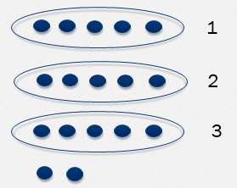
Over to you:
Try using arrays or a number linen to find the answer to one of these calculations:
18 ÷ 6
23 ÷ 5

Slide 11
Stage 2 into 3
For division calculations giving rise to remainders, children should begin to use a number line.
18 ÷ 4 =

Slide 12
Stage 3
For division calculations giving rise to remainders, children should begin to use a number line.
18 ÷ 4 = 4 r 2
Four jumps of four with two left over.

Slide 13
Stage 3
Children will continue to consolidate the use of a number line, moving away from using arrays. This normally appears as a horizontal number line, but can be used as a vertical one.

Slide 14
Stage 3
12 jumps of 4 so
48 ÷ 4 = 12

Slide 15
Stage 3
12 jumps of 4 with 2 left over
50 ÷ 4 = 12 r 2

Slide 16
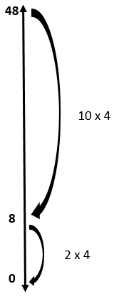
Stage 3
Some children will move towards ‘chunking’.
For 48 ÷ 4, this would involve jumping back 10 x 4 in one jump, then two further jumps of 4 (12 jumps of four in total, giving an answer of 12).

Slide 17
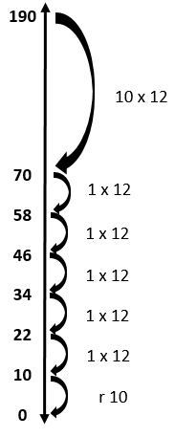
Stage 3
Chunking using larger numbers
190 ÷ 12
15 jumps of 12 and 10 left over
190 ÷ 12 = 15 r 10

Slide 18
Over to you:
Try using a number line and chunking to find the answer to one of these calculations:
24 ÷ 6
30 ÷ 4
170 ÷ 9

Slide 19
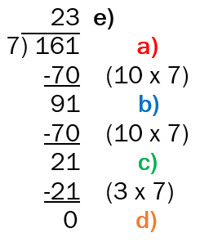
Stage 4
Moving into more formal vertical method
161 ÷ 7 =
Remove ten lots of seven from 161.
Continue removing ten lots of seven until you can no longer do this (91 – 70 = 21).
Once you reach a number whereby you can no longer take away ten lots of seven (21), divide this number by 7 (21 ÷ 7 = 3).
Check that there are no remainders.
Work out the number of groups of seven that you have subtracted.
10 groups + 10 groups + 3 groups = 23

Slide 20
Stage 4
Moving into more formal vertical method
161 ÷ 7 = 23
Remove ten lots of seven from 161.
Continue removing ten lots of seven until you can no longer do this (91 – 70 = 21).
Once you reach a number whereby you can no longer take away ten lots of seven (21), divide this number by 7 (21 ÷ 7 = 3).
Check that there are no remainders.
Work out the number of groups of seven that you have subtracted.
10 groups + 10 groups + 3 groups = 23

Slide 21
14 r 2
‘Chunking’ alongside formal ‘Bus Stop’ method
5)
72
- 50 (10 x 5)
22
- 20 (4 x 5)
2
72 ÷ 5 = 14 r 2
5 ) 7 2
Notes:
Chunking is efficient with larger numbers as shown on the slide. You have to think in terms of place value here – the 1 is in the 10s column, therefore it refers to 10 lots of the divisor.
The carried 2 refers to the 20 that is left.

Slide 22
14 r 2
5)
72
- 50 (10 x 5)
22
- 20 (4 x 5)
2
72 ÷ 5 = 14 r 2
10 lots of 5 are 50 and I have 20 left
5 ) 7 2
Notes:
Chunking is efficient with larger numbers as shown on the slide. Yu have to think in terms of place value here – the 1 is in the 10s column, therefore it refers to 10 lots of the divisor.
The carried 2 refers to the 20 that is left.

Slide 23
14 r 2
5)
72
- 50 (10 x 5)
22
- 20 (4 x 5)
2
72 ÷ 5 = 14 r 2
10 lots of 5 are 50 and I have 20 left
1
5 ) 7 2
Notes:
Chunking is efficient with larger numbers as shown on the slide. Yu have to think in terms of place value here – the 1 is in the 10s column, therefore it refers to 10 lots of the divisor.
The carried 2 refers to the 20 that is left.

Slide 24
14 r 2
5)
72
- 50 (10 x 5)
22
- 20 (4 x 5)
2
72 ÷ 5 = 14 r 2
10 lots of 5 are 50 and I have 20 left
1
5 ) 7 2
2
Notes:
Chunking is efficient with larger numbers as shown on the slide. Yu have to think in terms of place value here – the 1 is in the 10s column, therefore it refers to 10 lots of the divisor.
The carried 2 refers to the 20 that is left.

Slide 25
14 r 2
5)
72
- 50 (10 x 5)
22
- 20 (4 x 5)
2
72 ÷ 5 = 14 r 2
4 lots of 5 are 20 and I have 2 left
1 4 r 2
5 ) 7 2
2
Notes:
Chunking is efficient with larger numbers as shown on the slide. Yu have to think in terms of place value here – the 1 is in the 10s column, therefore it refers to 10 lots of the divisor.
The carried 2 refers to the 20 that is left.

Slide 26
Over to you:
Try using a more formal method involving chunking to find the answer to one of these calculations:
204 ÷ 6
192 ÷ 9

Slide 27
Stage 5
Formal Bus Stop Method (this should only be taught when teachers are certain that children are secure with place value relating to division).
In the past, some children have not used this method in primary education, and many schools chose not to teach this at Key Stage 2 at all.
However, this method will be taught more widely across Upper Key Stage 2 (Years 5 and 6) in the New Curriculum.

Slide 28
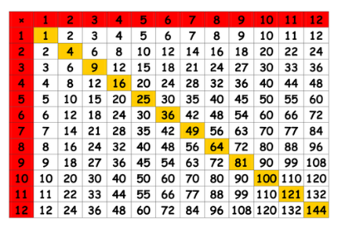
Times Tables
The more complex methods are reliant on children having a good knowledge of their times tables. It is therefore vital that children are putting in the time, both at home and in class, to learn their tables up to 12 x 12.

Slide 29
To conclude…
The aim is that children will master the formal methods during KS2.
If they do not grasp it but can use non-standard methods efficiently this does not always point to a major problem.
It is about having a toolbox of formal, informal and mental methods at the child’s disposal to use where appropriate, depending on the context.

Slide 30
To conclude…
It is essential that parents appreciate the approaches being used in school and back these up at home. If children are doing one thing at home and another at school, the child can easily become confused.
When working on addition, subtraction, multiplication and division in class, teachers will let parents know via the weekly slip in the homework diary which methods are currently being covered in class.

Slide 31
The Government Expectation
Addition and Subtraction:
By the end of Year 3, children to be adding and subtracting numbers with up to three digits, using formal written methods of columnar addition and subtraction.
Multiplication:
By the end of Year 4, children to be multiplying two and three digit numbers by a one digit number using formal written layout.
Division:
By the end of Year 5, children to be dividing numbers up to 4 digits by a one digit number using the formal written method of short division and interpret remainders appropriately for the context.

Slide 32
The Government Expectation
These are general expectations for progress. Some children will take longer to progress to these levels than others.
It is very important that children do not jump up towards more formal methods too early, without having fully worked through the stages outlined within this presentation.

