Slide 1
Calculation Policy – Years 3 and 4
Monday 22nd November 2021

Slide 3
National Curriculum 2014
Became statutory in September 2014
Expectations were raised.
The government expects children to be performing addition and subtraction calculations using formal written methods by the end of Year 3.
From this academic year onwards, schools in England will be required to administer an online multiplication tables check to year 4 pupils.

Slide 4
Why are methods different today?
A desire to do something different to counter the nation’s phobia around mathematics.
Development of understanding of effective methods to teaching mathematics since the mid-1990s.
Exploration of effective approaches from some of the most successful education systems in the world.
Extensive research and trialling.

Slide 5
There is no “right” way to work
Methods selected will depend upon the situation and the numbers involved, including when to use calculators. Efficiency is as important as accuracy.
Children make decisions about methods and draw on a range of strategies and approaches when applying maths in context.
Children in the same class could be using different methods to others depending on their ability, confidence and stage of mathematical development.

Slide 6
Concrete, Pictorial, Abstract
Concepts are introduced through hands on experiences.
Pupils visualise the concept and represent it pictorially through models like number lines.
Children then move onto abstract numbers and symbols when they have context to understand what they mean.

Slide 7
Addition

Slide 8
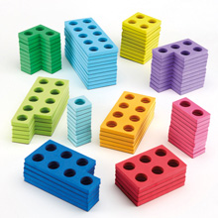
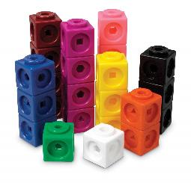
Stage 1
Using practical apparatus (Numicon, Multilink) and illustrations. This begins in Early Years Foundation Stage (Reception) and is consolidated into Year One.

Slide 9
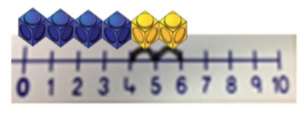
Stage 2
Using practical apparatus, pen and paper jottings (horizontally), working towards the number line.

Slide 10
Stage 2
42 + 33
40 + 30 = 70 (collect the ‘tens’ together)
2 + 3 = 5 (collect the ‘ones’ together – note the change in terminology from ‘units’ to ‘ones’).
70 + 5 = 75 (add the totals together)
Notes:
Could start the meeting with this question on the board – show the method that you would use to work out the answer?
Hundred squares on tables

Slide 11
Stage 2
Using a number line for TO + TO (number square to help).
42 + 33
Start at 42. Jump forward in tens 3 times. Then jump forward in ones three times.

Slide 12
Stage 2
Children would continue to consolidate the use of number lines at this stage, moving towards jumping to the next ten:
66 + 28
66 + 28 = 94

Slide 13
Stage 2
They could continue to use the method shown at Year 2.
66 + 28 =
Either of these methods are ok at this stage. It really depends on what works best for individual children.

Slide 14
Over to you:
Try using a number line to solve one of these calculations:
54 + 42
46 + 38

Slide 15
Stage 2
Some children will be very confident with partitioning the digits, and adding together.
66 + 28 =
60 + 20 = 80
6 + 8 = 14
80 + 14 = 94

Slide 16
Stage 2
Alternatively, children may prefer to work out this calculation as follows:
66 + 28 =
66 + 20 = 86
86 + 8 = 94
66 + 28 = 94
At this stage, children should be working out calculations horizontally, not looking at more formal vertical methods.

Slide 17
Stage 2
Children will continue to use horizontal methods (number line), but coming up against questions of a more difficult nature.
125 + 87
Here, the children could do eight jumps of ten. However, many children should now be confident enough to add this all in one go.

Slide 18
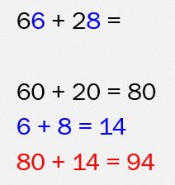
Over to you:
Try using partitioning or a number line to solve one of these calculations:
54 + 39
62 + 45
112 + 37

Slide 19
Stage 3
Once children are confident with horizontal methods, we would move into vertical methods.
Expanded Partitioning Method
This is set out vertically, in a similar fashion to the traditional form of addition.
215
+ 133

Slide 20
Stage 3
215
133 +
8 (5 + 3)
Start by adding together the least significant digits (the ones).

Slide 21
Stage 3
215
133 +
8 (5 + 3)
40 (10 + 30)
Then, add together the tens (10 + 30). Ensure these are referred to as tens, and not ‘1’ + ‘3’.

Slide 22
Stage 3
215
133 +
8 (5 + 3)
40 (10 + 30)
300 (200 + 100)
After this, add together the hundreds (200 + 100), again ensuring they are referred to as ‘hundreds’.

Slide 23
Stage 3
215
133 +
8 (5 + 3)
40 (10 + 30)
300 (200 + 100)
348
Then, add together each column.
8 + 0 + 0 = 8, 40 + 0 = 40, 300 + 0 = 300

Slide 24
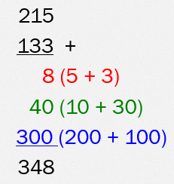
Over to you:
Try using expanded partitioning to solve one of these calculations:
342 + 145
481 + 518

Slide 25
Stage 4
Once children are confident in using these methods, they can then begin to use the traditional vertical method. It is important that they do not use this method until they are fully confident in their application of place value, and are secure in the methods talked through so far.
It is expected that children will begin to use this method towards the end of Year 3, but for some children, they will reach this stage at a later point.

Slide 26
Stage 4
215
+ 133
348
5 (ones) + 3 (ones) = 8 ones
1 (ten) + 3 (tens) = 4 tens
2 (hundreds) + 1 (hundred)= 3 (hundreds)
This method is quite straightforward. However, it becomes more difficult when children are asked to carry digits.

Slide 27
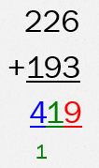
Stage 4
Start with the least significant digits (ones) 6 + 3 = 9.
Add the tens (2 + 9 = 11). Because the answer is a two digit number, it has to be carried under the hundreds.
Add the hundreds (2 + 1 = 3, + the ‘1’ being carried = 4)

Slide 28
Stage 4
This method can be extended to larger numbers…
2763
+ 1438
4201
¹ ¹ ¹

Slide 29
Stage 4
… and decimal numbers.
124.90
+ 117.25
242.15
¹ ¹

Slide 30
Possible problems with vertical methods
Children must ensure that they line up the digits appropriately e.g. ones under ones, tens under tens. If they don’t, they will end up adding the incorrect amounts together.
This can be a problem if a child’s presentation is poor.
Children may not remember to add the ‘carried’ digit, or place the carried digit in the incorrect column.

Slide 31
Over to you:
Try using the vertical column method to solve one of these calculations:
1254 + 2633
4586 + 2448
127.4 + 392.7

