Slide 1
Calculation Policy – Years 3 and 4
Monday 22nd November 2021

Slide 2
Multiplication

Slide 3
Table knowledge
Upon leaving Key Stage One (end of Year 2), all children should be secure in their knowledge of the 2x, 5x, and 10x tables.
A reminder that from this academic year onwards, schools in England will be required to administer an online multiplication tables check to year 4 pupils.

Slide 4
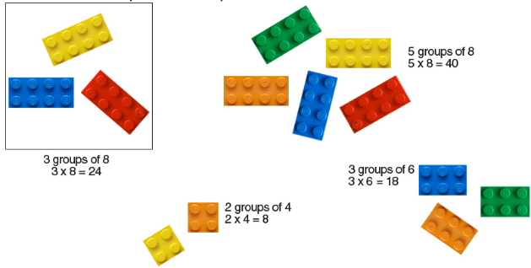
Stage 1 – Multiplication and Division
Practical use of halving, doubling and sharing, leading into repeated addition and basic use of the number line.

Slide 5
Stage 2
Multiplication Arrays
4 x 5 =

Slide 6
Stage 2
Multiplication Arrays
4 x 5 =

Slide 7
Stage 2
Multiplication Arrays
4 x 5 =

Slide 8
Stage 2
Multiplication Arrays
4 x 5 =

Slide 9
Stage 2
Multiplication Arrays
4 x 5 =

Slide 10
Stage 2
Multiplication Arrays
4 x 5 =
4 rows of 5

Slide 11
Stage 2
Switching the digits
(5 x 4)
No. of groups
Multiplication Arrays
4 x 5 = 20 5 x 4 = 20
4 rows of 5 5 rows of 4
Amount in each group

Slide 12
Stage 2
It may help a child to write the number of rows at the end of each ‘array’ drawn.
Multiplication Arrays
4 x 5 = 20 5 x 4 = 20
1 1
2 2
3 3
4 4
5
4 rows of 5 5 rows of 4

Slide 13
Stage 2
Alternatively, children may find it easier to write down the number they have reached at the end of each array.
Multiplication Arrays
4 x 5 = 20 5 x 4 = 20
5 4
10 8
15 12
20 16
20
4 rows of 5 5 rows of 4

Slide 14
Stage 2
It’s very important that each dot is lined up directly underneath the one above (one dot per square in the child’s maths book).
Multiplication Arrays
4 x 5 = 20 5 x 4 = 20
5 4
10 8
15 12
20 16
20
4 rows of 5 5 rows of 4

Slide 15
Stage 2
Empty number line
3 x 10 (3 jumps of 10).
Number the jumps at the top (useful when using multiple jumps, such as 8 jumps of 5).

Slide 16
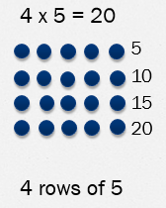
Over to you:
Try using arrays or an empty number line to find the answer to one of these multiplications:
8 x 7
6 x 9

Slide 17
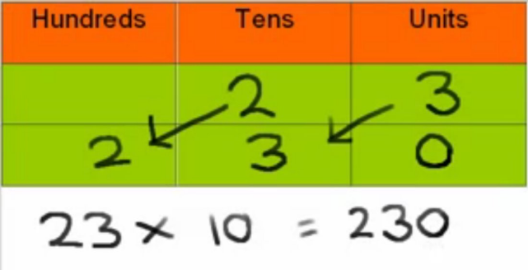
Multiplying by ten
When multiplying by ten, it is vitally important that children are not told to just ‘add on a zero.’

Slide 18
Multiplying by ten
When multiplying by ten, it is vitally important that children are not told to just ‘add on a zero.’
3 x 10 = 30
BUT WE DID NOT JUST ADD A 0!
If you add a 0, that means
3 + 0 = 3

Slide 19
Multiplying by ten
H T O

Slide 20
Multiplying by ten
H T O
7

Slide 21
Multiplying by ten
H T O
7
7

Slide 22
Multiplying by ten
H T O
7
7 0
seven tens = 70

Slide 23
Year 3
By the end of Year 3, children should be confident in their 2, 3, 4, 5, 8 and 10 times tables.

Slide 24
Stage 2
Children will continue to use the methods previously shown, but for more complex multiplication calculations, such as using arrays to work out 3 x 7 (3 groups of 7), or a number line to carry out three jumps of seven.
o o o o o o o
o o o o o o o
o o o o o o o

Slide 25
Year 4
By the end of Year 4, all children should be confident with all times tables up to 12 x 12, and the corresponding division facts.
Suggested order for learning tables:
10x, 5x, 2x, 4x, 8x, 3x, 6x, 9x, 7x, 11x, 12x

Slide 26
Stage 3
The Grid Method
The Grid Method is reliant on a solid knowledge of times tables.
13 x 8 = 104
Draw a grid as shown on the left. Partition the ‘thirteen’ into one ‘ten’ and ‘3’ ones.
Place the ‘8’ at the side and a multiplication symbol (x) in the top left hand corner.
Work out 10 x 8 (80)
Work out 3 x 8 (24).
80 + 24 = 104

Slide 27
Stage 3
Continuation of the grid method
23 x 8
Some children will prefer to break the ‘20’ down into two tens, therefore working out:
(10 x 8)
(10 x 8)
(3 x 8)

Slide 28
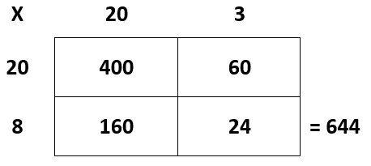
Stage 3
Further use of the grid method, for TO x TO
23 x 28
400 + 60 = 460
160 + 24 = 184
460 + 184 = 644

Slide 29
Over to you:
Try using the grid method to find the answer to one of these multiplications:
26 x 3
34 x 6
17 x 24

Slide 30
Stage 3 into Stage 4
The grid method is a popular and effective way of multiplying. It plays on knowledge of partitioning, draws on known facts and demonstrates what happens when you multiply by 10 or by 100.
It also highlights how many multiplication actions need to take place when working with long multiplication. For 23 x 28, four multiplications need to be undertaken, shown clearly in each cell in the grid.
All of the elements of this approach are the same as those needed in the standard method, but in the grid method they can be seen and you can easily tell if one of the multiplications has not taken place.

Slide 31
Stage 4
Partitioned Vertical Multiplication
47
x 8
Step 1 – set the calculation out as you would for using the traditional vertical method.

Slide 32
Stage 4
Partitioned Vertical Multiplication
47
x 8
56 (7 x 8)
Step 2 – multiply the one on the top line by the one on the bottom line.

Slide 33
Stage 4
Partitioned Vertical Multiplication
47
x 8
56 (7 x 8)
320 (40 x 8)
Step 3 – multiply the ‘ten’ on the top line by the one on the bottom line.

Slide 34
Stage 4
Partitioned Vertical Multiplication
47
x 8
56 (7 x 8)
320 (40 x 8)
376
Step 4 – add each column together
Ones (6 + 0)
Tens (50 + 20)
Hundreds (0 + 300)

Slide 35
Stage 4
52
x 17
14 (2 x 7)
20 (2 x 10)
350 (50 x 7)
500 (50 x 10)
884
The previous method can be extended for TO x TO

Slide 36
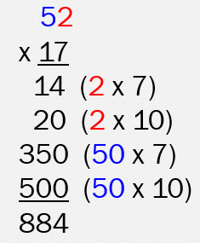
Over to you:
Try using partitioned vertical multiplication
to find the answer to one of these multiplications:
53 x 8
26 x 13

Slide 37
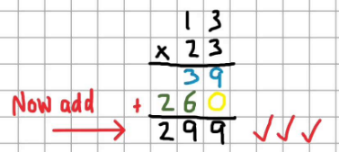
Stage 4 into Stage 5
Applying concepts taught through the grid method to a vertical layout prepares children for using the formal vertical method for multiplication.

Slide 38
Stage 5
4 7
x 8
6
⁵
Step 1 – multiply 7 by 8. This gives 56. Place the ‘one’ (6) in the ones column, and the ‘ten’ (5) under the tens column.

Slide 39
Stage 5
Step 2 – multiply the 8 by the 4 tens. This gives ’32’. Add the carried ‘5’ onto the 32 (37) and place in front of the 6 ones.
This gives an answer of 376.
4 7
x 8
3 7 6
⁵

Slide 40
Stage 5
Going further … 256 x 18
256
x 18
2048
⁴ ⁴
Follow the same method shown previously, to multiply the ‘8’ ones on the bottom line by the top number. Ensure that carried digits are added onto the total.

Slide 41
Stage 5
Going further … 256 x 18
256
x 18
2048
4 4
2560
Then, multiply the ‘ten’ on the bottom line by the digits on the top line. As you are multiplying by a ‘ten’, ensure that a ‘zero’ is placed in the ‘ones’ column before starting the calculations.

Slide 42
Stage 5
Going further … 256 x 18
256
x 18
2048
2560
4608
¹
Add the columns in each row together. Again, ensure that the carried digits are added to the total as you make your way across.

Slide 43
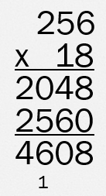
Over to you:
Try using the formal method of multiplication
to find the answer to one of these calculations:
132 x 7
243 x 16
345 x 28

Slide 44
Why not go straight into vertical methods?
The formal method holds many opportunities for errors (incorrect lining up of columns, forgetting about carried tens/hundreds etc).
Lack of understanding of size of numbers, therefore reasonableness of answers (using a number line earlier on helps to grasp a secure understanding of the number system).
Recognising when calculations are better carried out mentally, as opposed to a single reliance upon one method.
Understanding more than one method means that a calculation can be checked without the same error being included.

Slide 45
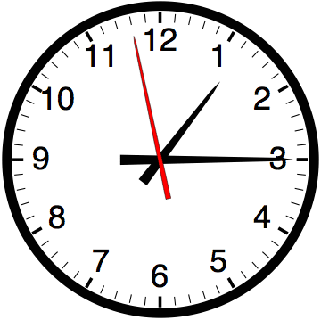
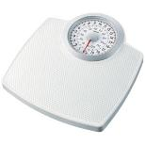
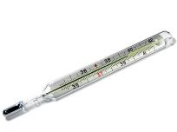
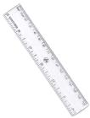
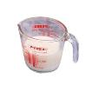
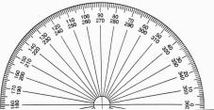
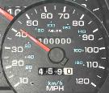
Number lines have their uses in a range of everyday situations

