Slide 1
Calculation Policy – Years 5 and 6
Wednesday 24th November 2021

Slide 2
Division

Slide 3
Stage 2
Division as repeated subtraction using a number line (15 ÷ 5 = 3)
Start from the right at 15. Jump back in fives until zero is reached. Count the number of jumps.

Slide 4
Stage 3
For division calculations giving rise to remainders, children should begin to use a number line.
18 ÷ 4 = 4 r 2
Four jumps of four with two left over.

Slide 5
Over to you:
Try a number line to find the answer to one of these calculations:
24 ÷ 6
33 ÷ 5

Slide 6
Stage 3
Children will continue to consolidate the use of a number line. This normally appears as a horizontal number line, but can be used as a vertical one.

Slide 7
Stage 3
12 jumps of 4 so
48 ÷ 4 = 12

Slide 8
Stage 3
12 jumps of 4 with 2 left over
50 ÷ 4 = 12 r 2

Slide 9
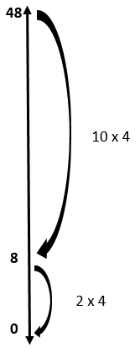
Stage 3
Some children will move towards ‘chunking’.
For 48 ÷ 4, this would involve jumping back 10 x 4 in one jump, then two further jumps of 4 (12 jumps of four in total, giving an answer of 12).

Slide 10
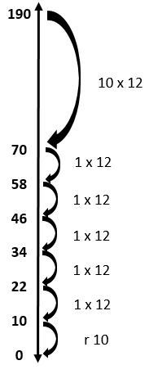
Stage 3
Chunking using larger numbers
190 ÷ 12
15 jumps of 12 and 10 left over
190 ÷ 12 = 15 r 10

Slide 11
Over to you:
Try using a number line and chunking to find the answer to one of these calculations:
32 ÷ 4
44 ÷ 6
172 ÷ 9

Slide 12
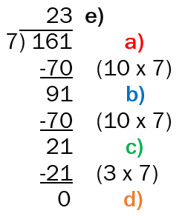
Stage 4
Moving into more formal vertical method
161 ÷ 7 =
a) Remove ten lots of seven from 161.
b) Continue removing ten lots of seven until you can no longer do this (91 – 70 = 21).
c) Once you reach a number whereby you can no longer take away ten lots of seven (21), divide this number by 7 (21 ÷ 7 = 3).
d) Check that there are no remainders.
e) Work out the number of groups of seven that you have subtracted.
10 groups + 10 groups + 3 groups = 23

Slide 13
Stage 4
Moving into more formal vertical method
161 ÷ 7 = 23
a) Remove ten lots of seven from 161.
b) Continue removing ten lots of seven until you can no longer do this (91 – 70 = 21).
c) Once you reach a number whereby you can no longer take away ten lots of seven (21), divide this number by 7 (21 ÷ 7 = 3).
d) Check that there are no remainders.
e) Work out the number of groups of seven that you have subtracted.
10 groups + 10 groups + 3 groups = 23

Slide 14
Over to you:
Try using a more formal method involving chunking to find the answer to one of these calculations:
204 ÷ 6
192 ÷ 9

Slide 15
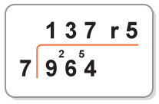
Stage 5
Formal Bus Stop Method (this should only be taught when teachers are certain that children are secure with place value relating to division).
In the past, some children have not used this method in primary education, and many schools chose not to teach this at Key Stage 2 at all.

Slide 16
‘Chunking’ alongside formal ‘Bus Stop’ method
5)
72
72 ÷ 5 =
5 ) 7 2
Notes:
Chunking is efficient with larger numbers as shown on the slide. Yu have to think in terms of place value here – the 1 is in the 10s column, therefore it refers to 10 lots of the divisor.
The carried 2 refers to the 20 that is left.

Slide 17
5)
72
- 50 (10 x 5)
22
72 ÷ 5 =
10 lots of 5 are 50 and I have 2 tens left
1
5 ) 7 2
2
Notes:
Chunking is efficient with larger numbers as shown on the slide. You have to think in terms of place value here – the 1 is in the 10s column, therefore it refers to 10 lots of the divisor.
The carried 2 refers to the 20 that is left.

Slide 18
14
5)
72
- 50 (10 x 5)
22
- 20 (4 x 5)
72 ÷ 5 =
1 4
4 lots of 5 are 20
5 ) 7 2
2
Notes:
Chunking is efficient with larger numbers as shown on the slide. Yu have to think in terms of place value here – the 1 is in the 10s column, therefore it refers to 10 lots of the divisor.
The carried 2 refers to the 20 that is left.

Slide 19
14 r 2
5)
72
- 50 (10 x 5)
22
- 20 (4 x 5)
2
72 ÷ 5 = 14 r 2
1 4 r 2
I have 2 ones left
5 ) 7 2
2
Notes:
Chunking is efficient with larger numbers as shown on the slide. Yu have to think in terms of place value here – the 1 is in the 10s column, therefore it refers to 10 lots of the divisor.
The carried 2 refers to the 20 that is left.

Slide 20
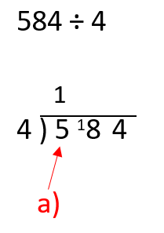
Stage 5
a) Work from the left hand side. How many fours in five (5 ÷ 4 = 1 r 1).
Place the ‘1’ on top of the ‘5’ and the remainder ‘1’ in front of the ‘8’ on the bottom row.

Slide 21
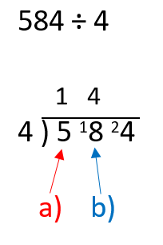
Stage 5
b) As a ‘one’ has been placed (carried) in front of the ‘8’, work out how many fours are in eighteen (18 ÷ 4 = 4 r 2).
Place the ‘4’ on top of the ‘8’ and the remainder ‘2’ in front of the ‘4’ on the bottom row.

Slide 22
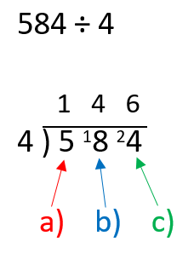
Stage 5
c) As a ‘two’ has been placed (carried) in front of the ‘four’, work out how many fours are in twenty four (24 ÷ 4 = 6). Place the ‘6’ on top of the ‘4’.
This leaves an answer of 146.
So 584 ÷ 4 = 146

Slide 23
Over to you:
Try using the bus stop method to find the answer to one of these calculations:
672 ÷ 4
882 ÷ 7

Slide 24
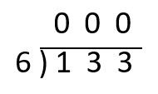
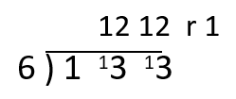
Common Errors
Can you see where each child has gone wrong?
Notes:
Common errors that are addressed through the progression in calculation. Ask what are the errors?
In the first one, a Y6 pupil who attained L5 at the end of KS2 had not understood the process. She felt that this was the way that she should be doing division, but the method was not working for her. She could not see her error until she reworked the problem, reverting back to chunking and successfully got the answer.
The second one is also from a child in Y6 who obtained L5. The child was using linked multiplication facts but was recording the wrong part of it. She knew that 2 lots of 6 was 12, but wrote the 12 rather than the 2 lots. She could not see her error (the fact that division of whole numbers is a reduction operation, so your answer should be smaller than the number that you are starting with because you are creating smaller groups from a larger group. She also got the answer when she worked through using chunking. Interestingly, she said that she wanted to use chunking because she understood it and could get the answer, but her dad had told her that it was not the proper way to carry out the calculation. He had shown her the short method, she had not understood, but wanted to do what dad had told her.

Slide 25
A year 6 pupil working at greater depth had not understood the bus stop process.
She felt that this was the way that she should be doing division, but the method was not working for her.
She could not see her error until she reworked the problem, reverting back to chunking and successfully calculating the answer.
Notes:
Common errors that are addressed through the progression in calculation. Ask what are the errors?
In the first one, a Y6 pupil who attained L5 at the end of KS2 had not understood the process. She felt that this was the way that she should be doing division, but the method was not working for her. She could not see her error until she reworked the problem, reverting back to chunking and successfully got the answer.
The second one is also from a child in Y6 who obtained L5. The child was using linked multiplication facts but was recording the wrong part of it. She knew that 2 lots of 6 was 12, but wrote the 12 rather than the 2 lots. She could not see her error (the fact that division of whole numbers is a reduction operation, so your answer should be smaller than the number that you are starting with because you are creating smaller groups from a larger group. She also got the answer when she worked through using chunking. Interestingly, she said that she wanted to use chunking because she understood it and could get the answer, but her dad had told her that it was not the proper way to carry out the calculation. He had shown her the short method, she had not understood, but wanted to do what dad had told her.

Slide 26
This example is also from a child in Y6 working at greater depth.
The child was using linked multiplication facts but was recording the wrong part of it. She knew that 2 lots of 6 was 12, but wrote the 12 rather than the 2 lots. She could not see her error.
She got the correct answer when she worked through the calculation using chunking.
Notes:
Common errors that are addressed through the progression in calculation. Ask what are the errors?
In the first one, a Y6 pupil who attained L5 at the end of KS2 had not understood the process. She felt that this was the way that she should be doing division, but the method was not working for her. She could not see her error until she reworked the problem, reverting back to chunking and successfully got the answer.
The second one is also from a child in Y6 who obtained L5. The child was using linked multiplication facts but was recording the wrong part of it. She knew that 2 lots of 6 was 12, but wrote the 12 rather than the 2 lots. She could not see her error (the fact that division of whole numbers is a reduction operation, so your answer should be smaller than the number that you are starting with because you are creating smaller groups from a larger group. She also got the answer when she worked through using chunking. Interestingly, she said that she wanted to use chunking because she understood it and could get the answer, but her dad had told her that it was not the proper way to carry out the calculation. He had shown her the short method, she had not understood, but wanted to do what dad had told her.

Slide 27
Stage 5
Formal ‘Bus Stop’ method to carry out long division
1152 ÷ 16
Set up in the same way as in the previous example.

Slide 28
Stage 5
Step 1 – as you are dividing by 16, you will need to count in multiples of this number. Use a vertical list.
Place 16 at the top of the list, then 160 at the bottom. Work out half of 160 (80), and place this at the half way stage. Then, count in multiples of 16, checking that the fifth multiple is 80, and the tenth multiple is 160.
16
32
48
64
80
96
112
128
144
160

Slide 29
Stage 5
16
32
48
64
80
96
112
128
144
160
Step 2 – Start on the left with 1 ÷ 16. You cannot perform this calculation in this context. Therefore, carry the ‘one’ over to the next digit, to make 11.

Slide 30
Stage 5
Step 3 – Next is 11 ÷ 16. Again, you cannot perform this calculation in this context. Therefore, carry the ‘one’ over to the next digit, to make 115.
16
32
48
64
80
96
112
128
144
160

Slide 31
Stage 5
Step 4 – Now try 115 ÷ 16. Check on the list for the closet number. 16 divides into 112 seven times. Place the ‘7’ on top of the ‘5’. There is still ‘3’ left over from this calculation; this needs to be carried in front of the ‘2’.
16
32
48
64
80
96
112
128
144
160

Slide 32
Stage 5
Step 5 – Lastly we need to calculate 32 ÷ 16. Check on the list for the closest number. 16 divides into 32 twice exactly. Place the ‘2’ on top of the ‘2’. This gives an answer of 72.
16
32
48
64
80
96
112
128
144
160

Slide 33
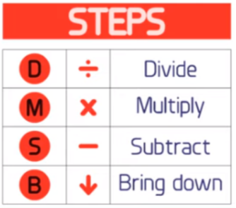
Stage 6
Formal long division

Slide 34
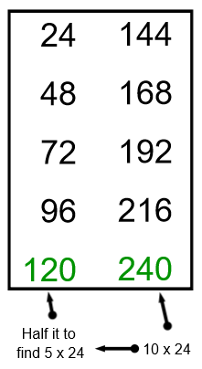
Stage 6
Formal long division
Stage 1: List the multiples of 24. Remember to find 10x and 5x as a guide.

Slide 35
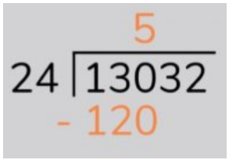
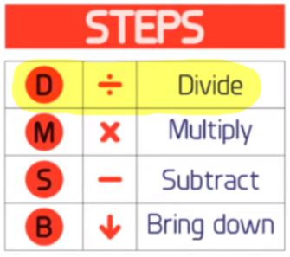
Stage 6
Formal long division
Stage 2: Divide: 130 ÷ 24 → 24 goes into 130 five times (I can see by looking through my list of multiples that 130 would be placed between 120, the 5th multiple, and 144, the 6th multiple).

Slide 36
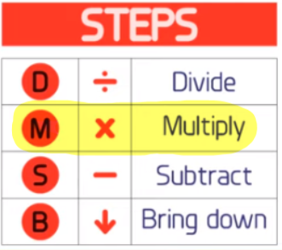
Stage 6
Formal long division
Stage 3: Multiply: 5 lots of 24 is 120. This is the number we need to work out the remainder to our first division (130 ÷ 24).

Slide 37
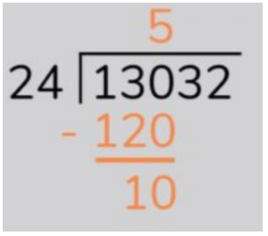
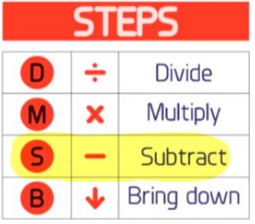
Stage 6
Formal long division
Stage 4: Subtract: 130 – 120 = 10, so this is the remainder to the first division (130 ÷ 24). This needs to be included in our next step.

Slide 38
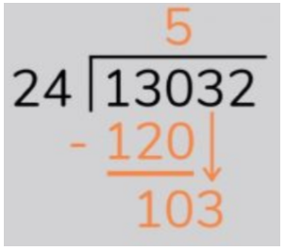
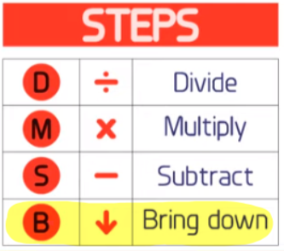
Stage 6
Formal long division
Stage 5: Bring the next digit down: bringing the 3 down makes my new number 103. I’ll then repeat the process again.

Slide 39
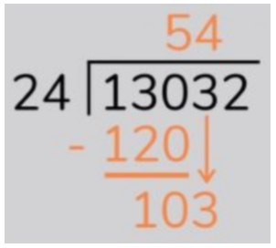
Stage 6
Formal long division
Stage 6: Divide: 103 ÷ 24 → 24 goes into 103 four times (I can see by looking through my list of multiples that 103 would be placed between 96, the 4th multiple, and 120, the 5th multiple).

Slide 40
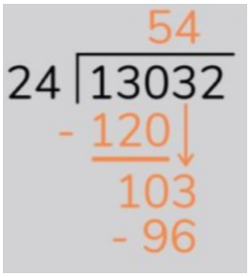
Stage 6
Formal long division
Stage 7: Multiply: 4 lots of 24 is 96. This is the number we need to work out the remainder from the second division (103 ÷ 24).

Slide 41
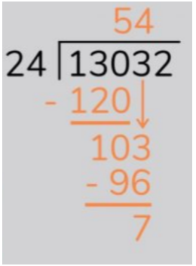
Stage 6
Formal long division
Stage 8: Subtract: 103 – 96 = 7, so this is the remainder to the second division (103 ÷ 24). This needs to be included in our next step.

Slide 42
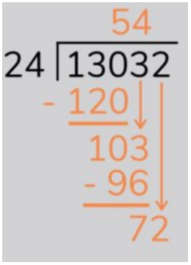
Stage 6
Formal long division
Stage 9: Bring the next digit down: bringing the final digit down creates my final number to work with: 72

Slide 43
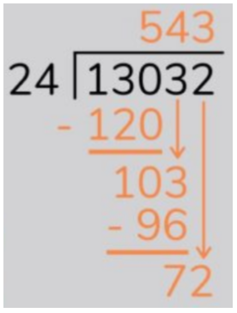
Stage 6
Formal long division
Stage 10: Divide: 72 ÷ 24 = 3.

Slide 44
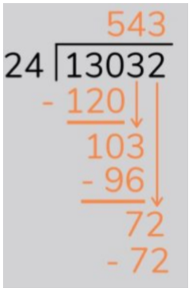
Stage 6
Formal long division
Stage 11: Multiply: 3 x 24 = 72.

Slide 45
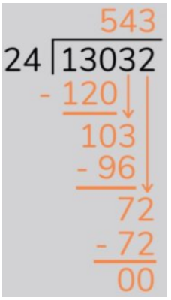
Stage 6
Formal long division
Stage 12: Subtract: 72 – 72 = 0. There is no remainder, so we know that the divisor must fit into the original number exactly. So our final answer is 12,032 divided by 24 is 543.

Slide 46
To conclude…
The aim is that children will master the formal methods during KS2.
If they do not grasp it but can use non-standard methods efficiently this does not always point to a major problem.
It is about having a toolbox of formal, informal and mental methods at the child’s disposal to use where appropriate, depending on the context.

Slide 47
To conclude…
It is essential that parents appreciate the approaches being used in school and back these up at home. If children are doing one thing at home and another at school, the child can easily become confused.
When working on addition, subtraction, multiplication and division in class, teachers will let parents know via the weekly slip in the homework diary which methods are currently being covered in class.

