Slide 1
Calculation Policy – Years 5 and 6
Wednesday 24th November 2021

Slide 2
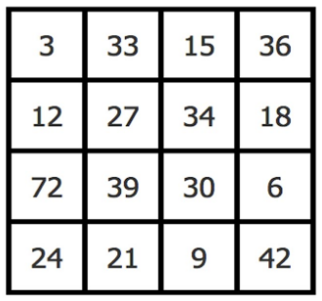
Which number is the odd one out? Why? (There could be more than one answer)

Slide 3
Why are methods different today?
A desire to do something different to counter the nation’s phobia around mathematics.
Development of understanding of effective methods to teaching mathematics since the mid-1990s.
Exploration of effective approaches from some of the most successful education systems in the world.
Extensive research and trialling.

Slide 4
There is no “right” way to work
Methods selected will depend upon the situation and the numbers involved, including when to use calculators. Efficiency is as important as accuracy.
Children make decisions about methods and draw on a range of strategies and approaches when applying maths in context.
Children in the same class could be using different methods to others depending on their ability, confidence and stage of mathematical development.

Slide 5
Addition

Slide 6
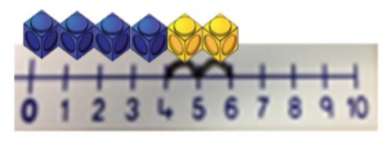
Stage 2
Using practical apparatus, pen and paper jottings (horizontally), working towards the number line.

Slide 7
Stage 2
42 + 33
40 + 30 = 70 (collect the ‘tens’ together)
2 + 3 = 5 (collect the ‘ones’ together – note the change in terminology from ‘units’ to ‘ones’).
70 + 5 = 75 (add the totals together)
Notes:
Could start the meeting with this question on the board – show the method that you would use to work out the answer?
Hundred squares on tables

Slide 8
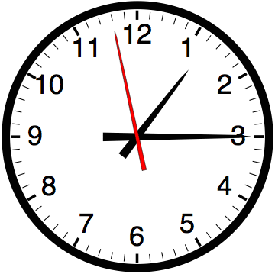
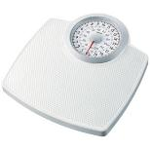
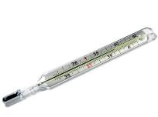
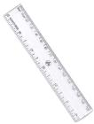
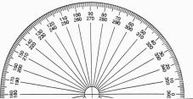
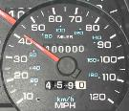
Number lines have their uses in a range of everyday situations

Slide 9
Stage 2
Using a number line for TO + TO (number square to help)
42 + 33
Start at 42. Jump forward in tens 3 times. Then jump forward in ones three times.

Slide 10
Stage 2
Children would continue to consolidate the use of number lines at this stage, moving towards jumping to the next ten:
66 + 28
66 + 28 = 94

Slide 11
Stage 2
Children will continue to use horizontal methods (number line), but coming up against questions of a more difficult nature.
125 + 87
Here, the children could do eight jumps of ten. However, many children should now be confident enough to add this all in one go.

Slide 12
Over to you:
Try using a number line to solve one of these calculations:
64 + 32
146 + 38

Slide 13
Stage 3
Once children are confident with horizontal methods, we would move into vertical methods.
Expanded Partitioning Method
This is set out vertically, in a similar fashion to the traditional form of addition.
215
+ 133

Slide 14
Stage 3
215
133 +
8 (5 + 3)
Start by adding together the least significant digits (the ones).

Slide 15
Stage 3
215
133 +
8 (5 + 3)
40 (10 + 30)
Then, add together the tens (10 + 30). Ensure these are referred to as tens, and not ‘1’ + ‘3’.

Slide 16
Stage 3
215
133 +
8 (5 + 3)
40 (10 + 30)
300 (200 + 100)
After this, add together the hundreds (200 + 100), again ensuring they are referred to as ‘hundreds’.

Slide 17
Stage 3
215
133 +
8 (5 + 3)
40 (10 + 30)
300 (200 + 100)
348
Then, add together each column.
8 + 0 + 0 = 8, 40 + 0 = 40, 300 + 0 = 300

Slide 18
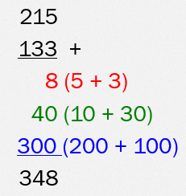
Over to you:
Try using expanded partitioning to solve one of these calculations:
432 + 156
381 + 517

Slide 19
Stage 4
Once children are confident in using these methods, they can then begin to use the traditional vertical method.
It is important that they do not use this method until they are fully confident in their application of place value, and are secure in the methods talked through so far.
It is expected that children will begin to use this method towards the end of Year 3, but for some children, they will reach this stage at a later point.

Slide 20
Stage 4
215
+ 133
348
5 (ones) + 3 (ones) = 8 ones
1 (ten) + 3 (tens) = 4 tens
2 (hundreds) + 1 (hundred)= 3 (hundreds)
This method is quite straightforward. However, it becomes more difficult when children are asked to carry digits.

Slide 21
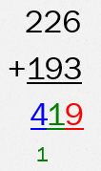
Stage 4
Start with the least significant digits (ones) 6 + 3 = 9.
Add the tens (2 + 9 = 11). Because the answer is a two digit number, it has to be carried under the hundreds.
Add the hundreds (2 + 1 = 3, + the ‘1’ being carried = 4)

Slide 22
Stage 4
This method can be extended to larger numbers…
2763
+ 1438
4201
¹ ¹ ¹

Slide 23
Stage 4
… and decimal numbers.
124.90
+ 117.25
242.15
¹ ¹

Slide 24
Possible problems with vertical methods
Children must ensure that they line up the digits appropriately e.g. ones under ones, tens under tens. If they don’t, they will end up adding the incorrect amounts together.
This can be a problem if a child’s presentation is poor.
Children may not remember to add the ‘carried’ digit, or place the carried digit in the incorrect column.

Slide 25
Over to you:
Try using the vertical column method to solve one of these calculations:
3145 + 6532
4286 + 3439
126.3 + 382.8

