Slide 1
Calculation Policy – Years 5 and 6
Wednesday 24th November 2021

Slide 2
Subtraction

Slide 3
Stage 2
Number line
73 – 21
Start at 73. Jump back in ‘tens’ twice (twenty). Then jump back one (one).

Slide 4
Stage 2
Consolidation of the number line method from Year 2, looking at using larger numbers.
124 – 48
Jump back to the nearest ten 124 – 4 = 120
Then subtract the remaining amount by jumping back in different sizes of jumps. The example above shows two jumps of ‘twenty’ but you could use four jumps of ‘ten’ or one jump of ‘forty’.

Slide 5
Stage 2
Number line (left to right – finding the difference)
84 – 56
Start from 56 and jump to the nearest ten. Continue jumping until reaching 84.
4 + 10 + 10 + 4 = 28
This method should be used when finding a small difference between numbers (when the two numbers are close together e.g. 84 – 77).

Slide 6
Stage 2
Use of an empty number line (right to left) for HTO – TO and HTO – HTO
354 – 186

Slide 7
Over to you:
Try using a number line to solve one of these calculations:
73 – 48
357 - 143

Slide 8
Stage 3
Expanded partitioning without exchanging
96 – 42
96 = 90 + 6
- 42 = 40 + 2
54 50 + 4
Step 1 – write the calculation vertically
Step 2 – partitioning
Step 3 – column subtraction

Slide 9
Stage 3
Expanded partitioning with exchanging
1) Write the calculation vertically
193
- 66

Slide 10
Stage 3
Expanded partitioning with exchanging
2) Partition the digits
193 = 100 + 90 + 3
- 66 = 0 + 60 + 6

Slide 11
Stage 3
Expanded partitioning with exchanging
3) Subtract the ones column. As you cannot do ‘3 – 6’, you must exchange from the tens column, bringing one ten into the ones column (thus taking one ten away from the tens column). 13 – 6 = 7
80
193 = 100 + 90 + 13
- 66 = 0 + 60 + 6
7

Slide 12
Stage 3
Expanded partitioning with exchanging
4) Subtract the tens column (80 – 60 = 20).
80
193 = 100 + 90 + 13
- 66 = 0 + 60 + 6
20 + 7

Slide 13
Stage 3
Expanded partitioning with exchanging
5) Subtract the hundreds column (100 – 0 = 100).
80
193 = 100 + 90 + 13
- 66 = 0 + 60 + 6
100 + 20 + 7

Slide 14
Stage 3
Expanded partitioning with exchanging
6) Add the digits together (100 + 20 + 7 = 127)
80
193 = 100 + 90 + 13
- 66 = 0 + 60 + 6
127 100 + 20 + 7

Slide 15
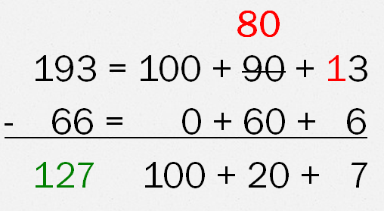
Over to you:
Try using expanded partitioning with exchanging to solve one of these calculations:
363 – 147
548 – 175

Slide 16
Stage 3 into Stage 4
As for addition, once children are confident in using these methods, they can begin to use the more formal traditional method for subtraction.

Slide 17
Stage 4
₈ ₁
193
- 66
127
As the one on the top line is smaller than the one on the bottom line, you must exchange from the tens column - the ‘3’ becomes ‘13’ and the ‘9’ (tens) becomes ‘8’ (tens).

Slide 18
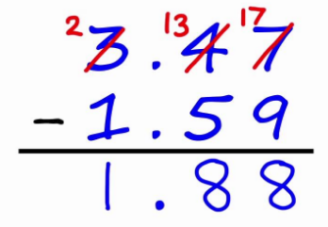
Stage 4
This method continues through to Year 6, with more complex questions involving larger numbers and decimals.

Slide 19
Possible problems with vertical methods
As for addition, the columns must be lined up accurately (ones on top of ones, tens on top of tens etc).
Children may try to swap round the digit on the top with the one on the bottom. This will obviously completely change the question that they are trying to answer.
Children may forget to exchange digits, or try to subtract from a digit that has been exchanged.

Slide 20
Espresso, Purple Mash and Times Table Rock Stars
Please see the log-in information within your child’s homework diary for access to these resources.

Slide 21
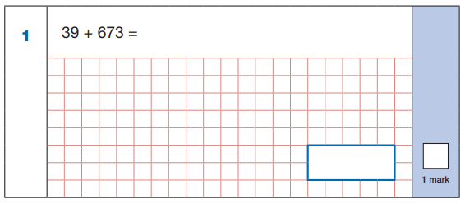
Key Stage 2 SATs
Three mathematics papers
Paper 1 – Arithmetic (30 mins, 36 questions)
Papers 2 and 3 – Reasoning (40 mins, 20 questions approx.)

Slide 22
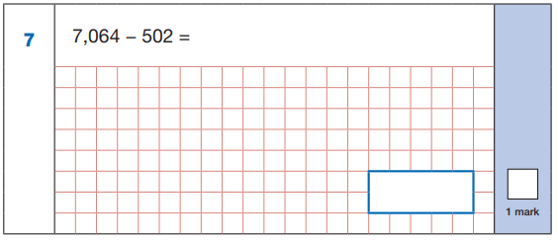
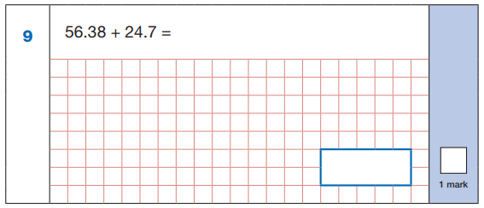
Paper One Example Questions

Slide 23
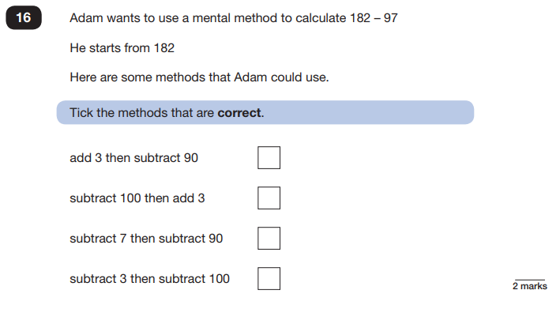
Paper 2/3 Example Question

